Slide 1
STUDENT PERFORMANCE ANALYSIS
Submitted by:
VISMAYA M
DATA SCIENCE

Slide 2
INTRODUCTION
The student performance dashboard is an interactive visualization tool developed to analyze and track ‘students’ academic performance efficiently.
It presents key indicators such as exam scores attendance, subject wise performance, and overall grades in a structure and visual format.
It helps educators and institutions identify performance trends, compare students across subject or classes and recognize areas requiring academic improvements.

Slide 3
OBJECTIVE
Analyze students academic performance.
Identify trends and patterns in scores, attendance and subject wise performance.
Compare performances across student, classes and academic periods.
Identify low-performing and high-performing students for timely academic intervention.
To support data-driven decision-making for educators and academic administrators.

Slide 4
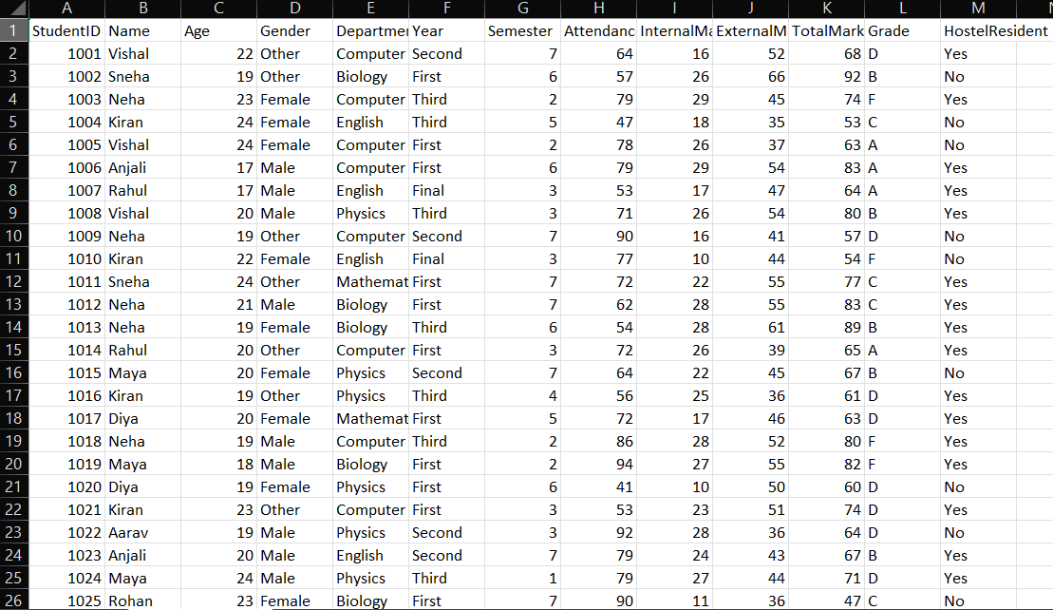
DATASET USED

Slide 5
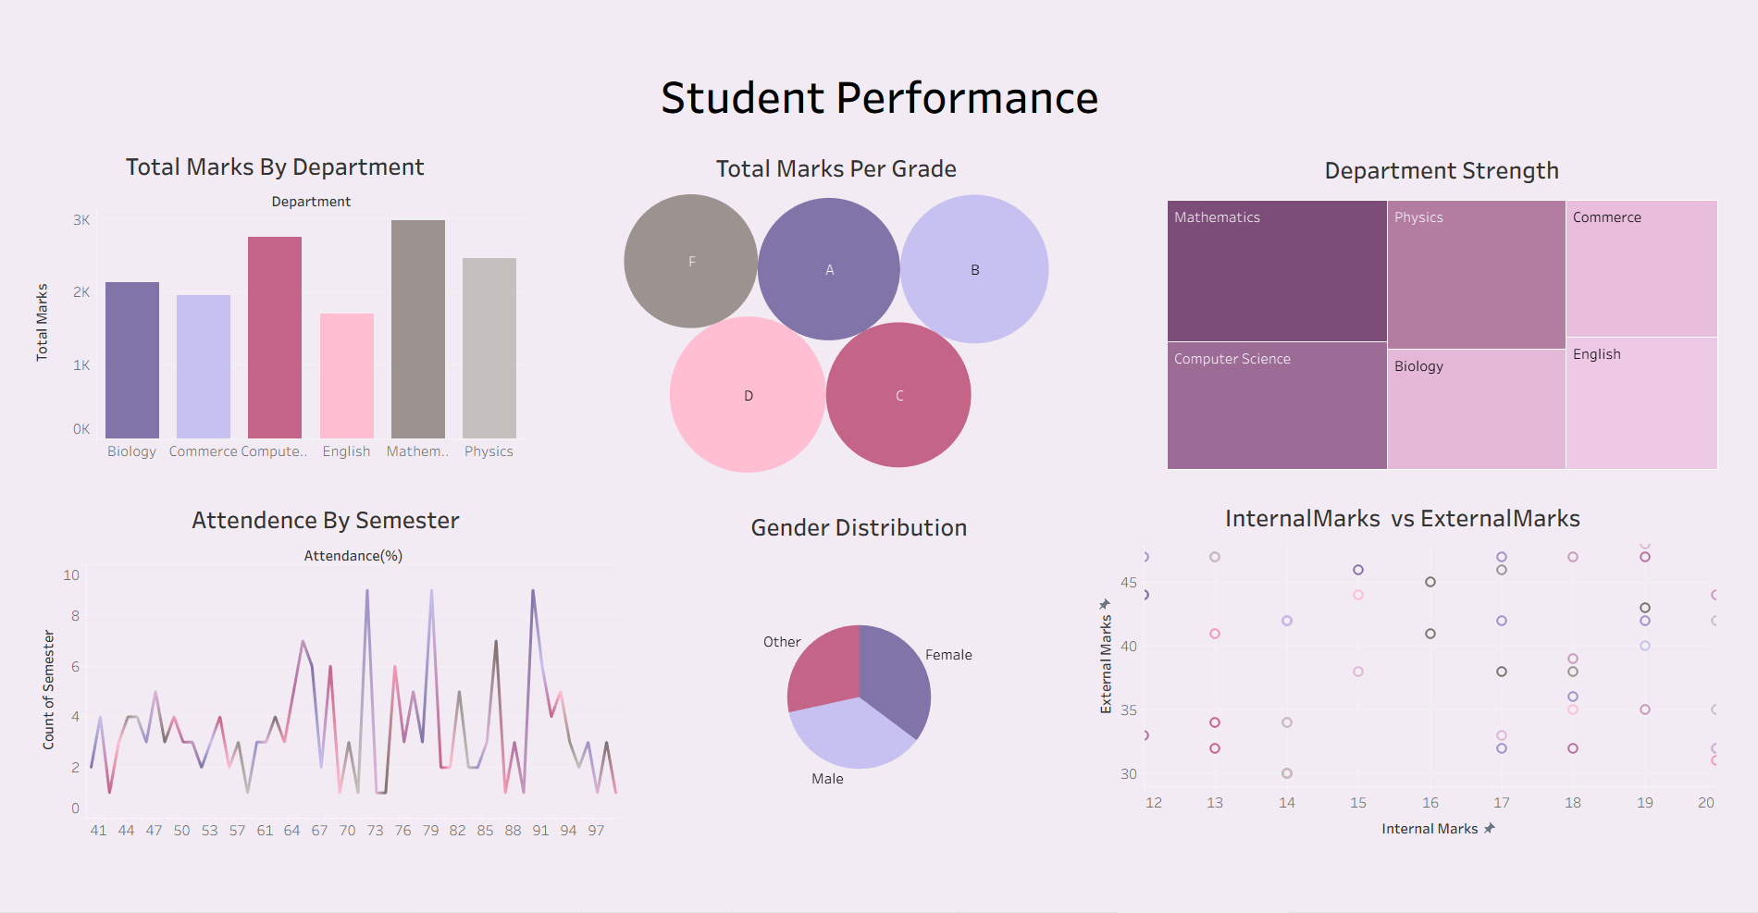
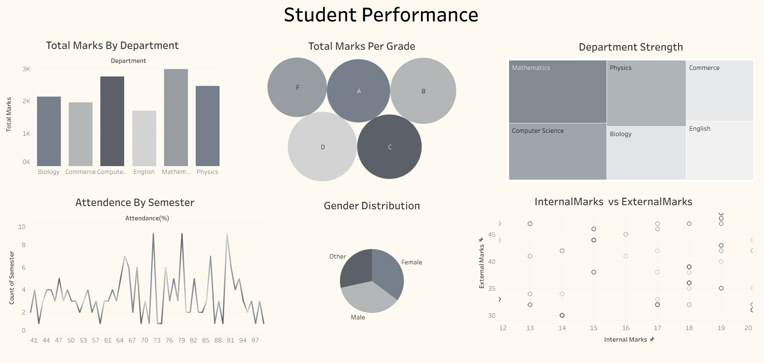
DASHBOARD

Slide 6
CRITERIA USED
Total Marks by Department
Total Marks by Grade
Department Strength
Attendance by Semester
Gender Distribution
Internal Marks vs External Marks

Slide 7
CONCLUSION
Dashboard created using tableau.
Students performance analysed.
Key metrics like marks, attendance and subject wise performance summarized.
Easy identification of performance trends and learning gaps.
Helps educators recognize high achievers monitor at risk students and plan timely academic interventions.

Slide 8
SUGGESTIONS
Provide additional academic support and mentoring for low performing students.
Use attendance monitoring to identify students at risk of poor performance early.
Encourage regular performance reviews.
Conduct subject wise remedial classes for areas with consistently low scores.
Integrate parent teacher feedback for student improvement.

Slide 9
Thankyou!!...

